Slide 1
Sales Performance Dashboard
Submitted By
ANJANA P P

Slide 2
Objective
The objective of this dashboard is to analyze sales performance and provide business insights through interactive visualizations.
Tool Used
Microsoft Power BI
Dataset
Sample Sales Dataset (CSV)

Slide 3
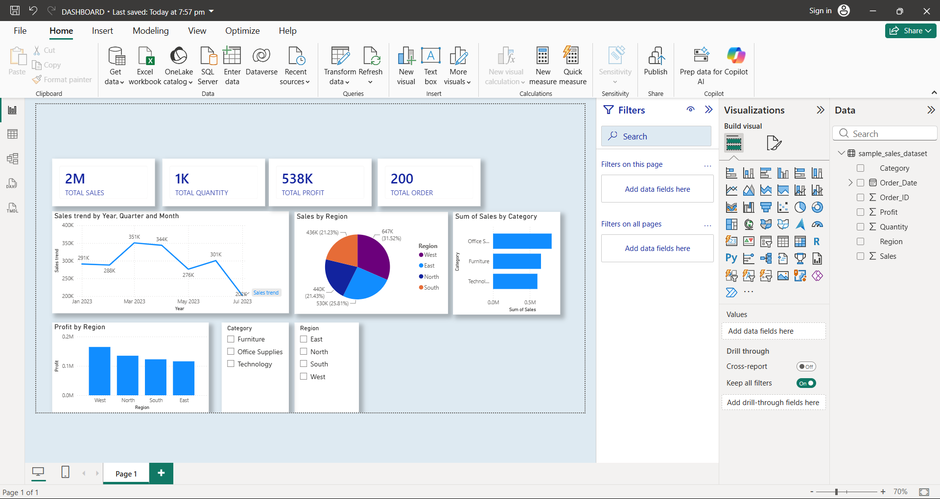
Dashboard Overview

Slide 4
Dashboard Features
KPI Cards (Sales, Profit, Quantity, Orders)
Monthly Sales Trend
Sales by Category
Sales by Region
Profit by Region
Interactive Region and Category Filters

Slide 5
Business Insights
Key Findings
Total Sales reached 2M.
Total Profit is 538K.
Total Quantity sold is 1K.
Sales fluctuate over different months.
West region generated the highest profit.
Office Supplies is the highest-selling category.

Slide 6
Conclusion
This interactive Power BI dashboard helps business stakeholders to:
Monitor Sales Performance
Compare Regional Performance
Analyze Product Categories
Track Monthly Sales Trends
Make better business decisions using interactive filters

Slide 7
THANKYOU

